Slide 1
INTELLIGENT PLATFORM
FOR SUPERVISION AND SECURITY
AUTOMATED
Design and deployment of a centralized supervision platform
and security with artificial intelligence and automated response
GHAZI MABROUKI
ArcTic 3 | Huawei Enterprise
Cloud Department — Innovation Department
2026
1

Slide 2
TABLE OF CONTENTS
Presentation Content
01
Introduction & Context
06
Phase 3 — Backend Intelligence
02
Existing Solutions
07
Functional & Non-Functional Requirements
03
Architecture & Proposed Solution
08
Testing Strategy
04
Phase 1 — Monitoring Foundation
09
Methodology
05
Phase 2 — Cloud Infrastructure
10
Conclusion
Ghazi Mabrouki | Huawei Enterprise — Cloud Department
2

Slide 3
01
INTRODUCTION & CONTEXT
Project context, identified challenges and strategic stakes
3

Slide 4
CONTEXT AND CHALLENGES
FRAGMENTED SOLUTIONS
HETEROGENEOUS DATA
Monitoring solutions are multiple and non-centralized, complicating global infrastructure management.
Data from different sources is difficult to analyze in a unified and coherent manner.
EXPERT DEPENDENCY
TECHNICAL ALERTS
Incident analysis relies heavily on experts, slowing detection and response.
Generated alerts are technical and difficult for non-experts to interpret quickly.
LACK OF AUTOMATION
Corrective actions are not systematically automated, increasing reaction time to threats. Result: slower response, missed multi-stage attack patterns, and analyst burnout.
Result: Slower incident response, missed multi-stage attack patterns, and analyst fatigue due to manual correlation across disconnected tools.
Introduction & Context
04

Slide 5
PROJECT OBJECTIVES
1
COMPLETE VISIBILITY
Monitor network, host, runtime and infrastructure layers in a unified stack. No blind spots — every critical layer observed, collected and centralized.
2
INTELLIGENT PROCESSING
Transform raw alerts into enriched and correlated incidents with AI analysis. From data overload to actionable and contextualized intelligence.
3
CONTROLLED RESPONSE
Automate investigation, playbook generation, approval workflows and Ansible remediation with full audit. The platform thinks before acting.
Introduction & Context
05

Slide 6
02
EXISTING SOLUTIONS
State of the art of monitoring and security solutions on the market
6

Slide 7
STATE OF THE ART OF SOC SOLUTIONS
Category | Examples | Limitations
Traditional SIEM | Splunk, QRadar, ArcSight | Centralized collection but expensive and complex to deploy
EDR / XDR | CrowdStrike, SentinelOne | Focused on endpoints, limited network visibility
SOAR | Palo Alto XSOAR, Splunk SOAR | Advanced orchestration but costly integration
Open-Source | Wazuh, Suricata, ELK Stack | Powerful but not natively integrated
Cloud Platforms | Azure Sentinel, Chronicle | Vendor lock-in, limited customization
IDENTIFIED GAP
No solution combines multi-layer monitoring, automatic enrichment, incident correlation, AI analysis and automated remediation in a unified architecture deployable on cloud.
Existing Solutions
07

Slide 8
03
ARCHITECTURE & PROPOSED SOLUTION
Global architecture of the SOC platform and data flows between components
8

Slide 9
GLOBAL PLATFORM ARCHITECTURE
PHASE 1
Monitoring Foundation
PHASE 2
Cloud Infrastructure
PHASE 3
Backend Intelligence
GLOBAL DATA FLOW
Kibana
Visualization
Sources
Security
Collection
Layer
Elasticsearch
Storage & Indexing
Backend
Intelligence
Frontend Dashboard
Alerts, Incidents, Metrics
Phase 1 — Monitoring Foundation: Layer, detection, storage, and visualization of security events.
Phase 2 — Cloud Infrastructure: Deployment on Huawei Cloud with VPC, Security Groups, and optimized ECS VM.
Phase 3 — Backend Intelligence:Enrichment, correlation, AI analysis, playbook generation, and Ansible remediation.
Result: A unified SOC platform that sees everything, understands patterns and responds with control.
Architecture & Solution
09

Slide 10
04
PHASE 1: MONITORING FOUNDATION
Building the visibility backbone of the SOC platform
10

Slide 11
PHASE 1 — VISIBILITY LAYERS & TOOLS
Layer | Tool | Role
Network | Suricata | Traffic, packets, protocols, IDS alerts
Host / Endpoint | Wazuh | Auth events, file integrity, agent alerts
Runtime | Falco | Process behavior, syscalls, containers
Infrastructure | Telegraf | CPU, RAM, disk, load, system health
Collection | Filebeat | Layer et transfert des logs vers Elasticsearch
Collection | Falcosidekick | Transfer of Falco alerts
Analysis & Viz | Elasticsearch | Central storage, indexing, search + Kibana dashboards
Result: Layered architecture that eliminates blind spots. The system observes network, hosts, runtime and resources — all centralized and visualized together.
Phase 1 — Monitoring Foundation
11

Slide 12
PHASE 1 — ARCHITECTURE & DATA FLOW
SOURCES
COLLECTION
System Logs
Auth Logs
Filebeat
Reads and sends logs
ELASTICSEARCH
KIBANA
Suricata IDS
Wazuh HIDS
Port 9200 HTTPS
Port 5601 HTTPS
Falco
Telegraf
Falcosidekick
Receives Falco alerts
Central Storage
Indexing
Search
Receives: Filebeat, Falcosidekick, Telegraf
Dashboards
Monitoring
Analysis & Exploration
Telegraf
ES direct
GLOBAL LOGIC
Main flow: Sources → Collection Layer → Elasticsearch → Kibana
System / auth logs → Filebeat | Suricata → eve.json → Filebeat | Wazuh alerts → Filebeat
Falco alerts → Falcosidekick | Telegraf metrics → Elasticsearch (direct)
Filebeat & Falcosidekick → Elasticsearch | Elasticsearch → Kibana
Phase 1 — Monitoring Foundation
12

Slide 13
PHASE 1 — DEPLOYMENT & RESULT
HARDWARE RESOURCES
DEPLOYED SERVICES
Level | CPU | RAM | Disk
Minimum | 4 cores | 8 GB | 50 GB
Recommended | 8 cores | 16 GB | 100 GB
Native Services
Docker Services
Elasticsearch (9200), Kibana (5601)
Filebeat, Suricata, Wazuh (1514/1515)
Telegraf
Falco (runtime detection)
Falcosidekick (2801)
WHY THIS ARCHITECTURE?
The SIEM core remains stable and centralized
Runtime detection isolated in containers
Simple and maintainable architecture
FINAL RESULT — PHASE 1
Complete security monitoring foundation with global visibility on network, host, runtime and resources. All tools are centralized in Elasticsearch and visualized via Kibana.
→ Ready for Phases 2 and 3
Phase 1 — Monitoring Foundation
13

Slide 14
05
PHASE 2: CLOUD INFRASTRUCTURE
Deployment of the SOC platform on Huawei Cloud
14

Slide 15
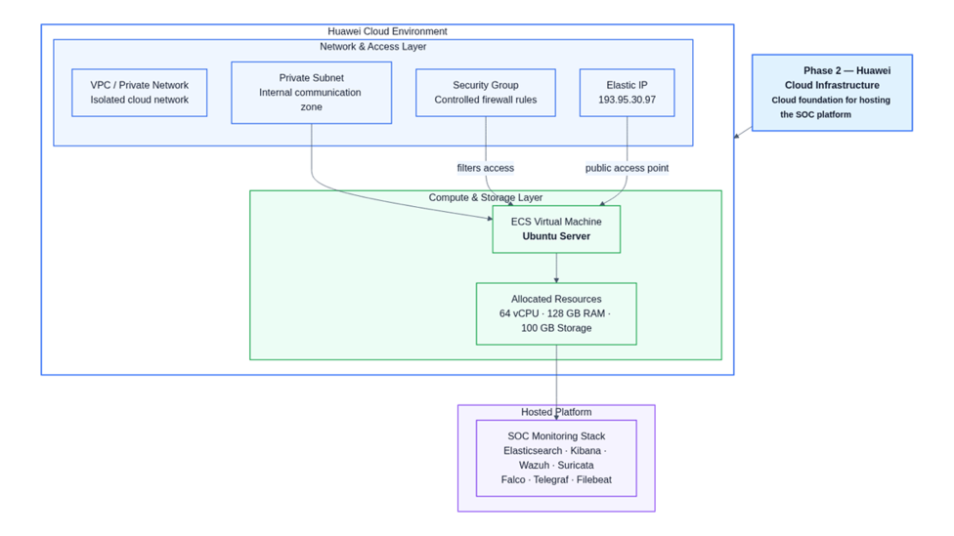
PHASE 2 — HUAWEI CLOUD ENVIRONMENT
ECS VM SPECIFICATIONS
64 vCPU — Computing power
128 GB RAM — Memory for ES and analysis
100 GB Storage — OS, indices, logs
OS: Ubuntu Server
Public IP: 193.95.30.97
HOSTED SOC STACK
Elasticsearch · Kibana · Wazuh · Suricata
Falco · Telegraf · Filebeat · Docker
This cloud foundation hosts the complete SOC stack and enables secure expansion.
NETWORK ARCHITECTURE
VPC
Network prive isole
Private Subnet
Internal communication zone
Security Group
Controlled firewall rules
Elastic IP
193.95.30.97
Phase 2 — Cloud Infrastructure
15

Slide 16
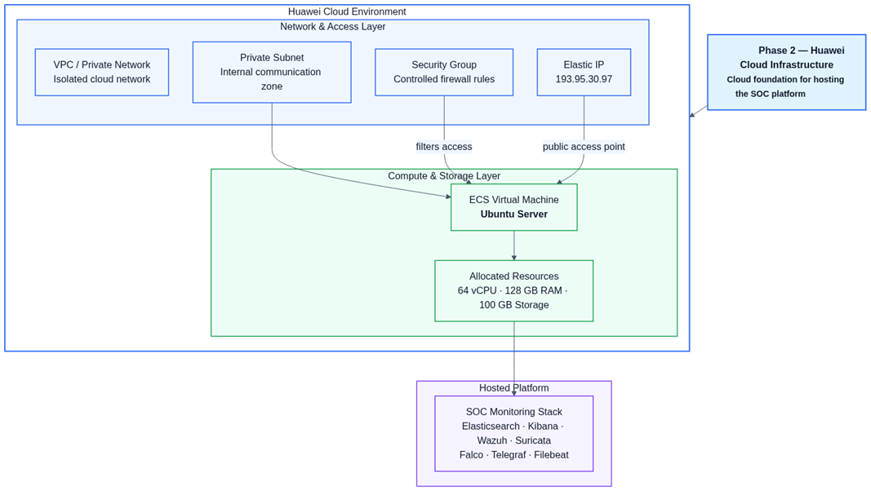
16

Slide 17
PHASE 2 — SECURITY STRATEGY & INTEGRATION
Service | Port | Exposure
SSH | 22 | Admin IP only
Kibana | 5601 | Admin / VPN / public if required
Elasticsearch | 9200 | publicly exposed
Wazuh Events | 1514 | If external agents only
Wazuh Reg. | 1515 | If external agents only
Falcosidekick | 2801 | Internal only
Backend API | 8000/8001 | Reverse proxy recommended
HTTP/HTTPS | 80/443 | Reverse proxy + TLS
CRITICAL PRINCIPLE
Elasticsearch must remain internal.
PROJECT INTEGRATION
• Connects theoretical architecture to real operations
• Fully hosts the SOC stack
• Enables secure expansion
• ECS Ubuntu VM hosts all tools
• Foundation for intelligence layer
This phase supports the project by:
• Providing secure and scalable cloud infrastructure for the entire SOC platform
• Guaranteeing network isolation and access control via Security Groups and VPC
• Laying the groundwork for backend intelligence layer deployment (Phase 3)
Phase 2 — Cloud Infrastructure
17

Slide 18
06
PHASE 3: BACKEND INTELLIGENCE LAYER
From raw data to intelligent and verified SOC operations
18

Slide 19
PHASE 3 — GLOBAL OVERVIEW
INTELLIGENCE FLOW
Raw data
Normalized alerts
Correlated incidents
Investigations
AI Analysis
Playbooks
Approval
Execution
Archives
12 KEY STEPS
1
Ingestion & Enrichment
2
Alert Transformation
3
Contextual Enrichment
4
Local Storage (SQLite)
5
Incident Correlation
6
Investigation Creation
7
AI Response Engine
8
Workflow d'Approval
9
Execution & Verification
10
Performance Monitoring
11
Visualization IPS
12
AI Assistant & AI Operator
Phase 3 : Transforms raw Elasticsearch data into intelligent SOC operations: normalized alerts, correlated incidents, investigations, AI analysis, playbooks, approval, Ansible execution, verification, and archiving.
Phase 3 — Backend Intelligence
19

Slide 20
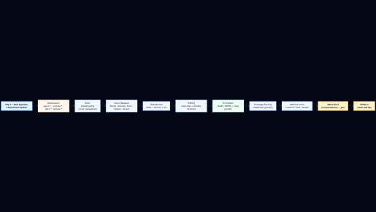
STEP 1 — ALERT INGESTION & ENRICHMENT
ELASTICSEARCH SOURCES
PROCESSING PIPELINE
wazuh-alerts-* — Wazuh Alerts (HIDS)
suricata-* — Suricata Alerts (NIDS)
falco-events-* — Falco Events (runtime)
filebeat-* / telegraf-* — Logs and metrics
Poll ES → Mappers sources → Deduplication
→ Noise Filter → Enrichissement (GeoIP + MITRE)
→ Detection campagne → Whitelist check
→ Persistance SQLite
RESULTAT
Normalized alerts propres
With: source, source ID, title, severity, category, IPs, hostname, tags, IOCs, MITRE techniques, metadata, deduplication key, and occurrence count.
• Visible in /alerts and /ips
• Ready for incident correlation
• Real-time updates via WebSocket
Phase 3 — Backend Intelligence
20

Slide 21
21

Slide 22
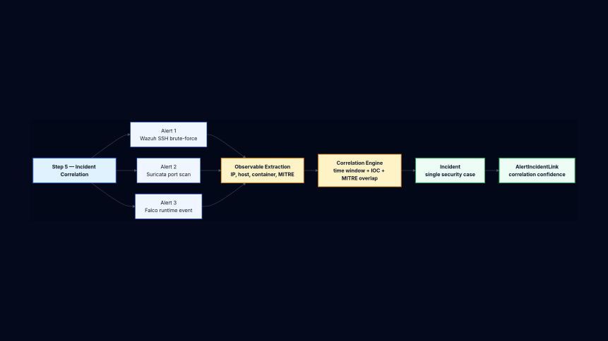
STEP 2 — INCIDENT CORRELATION
CORRELATION SIGNALS
▸ IP Source — same attack origin
▸ Hostname / Container ID — same target
▸ attaque Pattern — tactiques MITRE
▸ Kill-chain progression — steps of attaque
▸ Time Window — repeted alertes
Observable Extraction: IP, host, container, MITRE → Correlation Engine: time window + IOC + MITRE overlap
CORRELATION EXAMPLE
Suricata detecte
a port scan
Wazuh detecte SSH
brute force (same IP)
Falco detecte
shell activity
+
+
= A high-severity incident with high confidence: "SSH Brute Force & Port Scan Campaign from 185.220.101.4"
Phase 3 — Backend Intelligence
22

Slide 23
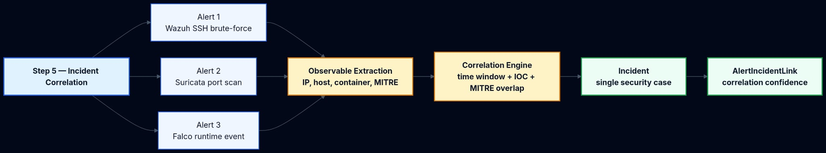
23

Slide 24
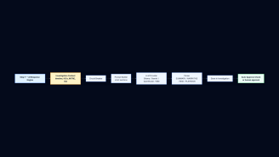
STEP 3 — INVESTIGATION & AI ENGINE
AUTOMATIC INVESTIGATION
AI RESPONSE ENGINE
The watcher monitors open incidents and automatically creates investigations with rich context:
▸ Complete timeline of related alerts
▸ IOCs: IPs, ports, services, domains
▸ MITRE tactics and techniques
▸ Behavioral & auth patterns
▸ Dynamic risk score
Automatically generates:
▸ Investigation summary
▸ Attack chain narrative
▸ Risk assessment
▸ Playbook YAML remediation
YAML syntax validation + auto-approval check
SUPPORTED LLM PROVIDERS
Ollama (Local)
Google Gemini
OpenRouter
NVIDIA NIM
Important: The system does not execute blindly — output goes through approval and validation before any action.
Phase 3 — Backend Intelligence
24

Slide 25
25

Slide 26
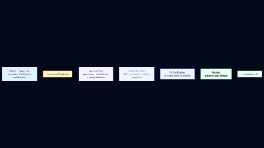
STEP 4 — APPROVAL, EXECUTION & VERIFICATION
APPROVAL TYPES
MANUAL
AUTO-APPROVED
BLOCKED
The analyst examines and decides on the action
Low-risk cases only
Critical / high-risk cases
EXECUTION CONTROLS
VERIFICATION RESULTS
▸ YAML playbook syntax validation
▸ Pre-execution SSH connectivity verification
▸ Target whitelist protection
▸ Complete execution logging
Status | Meaning
likely_fixed | Success, no new alerts
not_fixed | Alerts continue
inconclusive | Remaining ambiguous signals
Fundamental principle: The backend never executes blindly. Every remediation action goes through a controlled approval workflow with complete audit — from detection to archiving.
Phase 3 — Backend Intelligence
26

Slide 27
27

Slide 28
PHASE 3 — OPERATIONAL MODULES
PERFORMANCE MONITORING
IPS ATTACK VISUALIZATION
Continuous polling of metrics telegraf-*
Anomaly detection by thresholds and statistical baselines
Performance investigation creation
Generation of playbooks de remediation dynamiques
Metrics: CPU, RAM, disk, network, load, processes, TCP
Geo-enriched global map of attacks
Attack paths with lifecycle status
Real-time events on the map
Attack statistics and categories
Categorys: brute-force, web attack, recon, malware, DoS,
AI ASSISTANT
AI OPERATOR
Interface conversationnelle pour les analystes
Contextual questions with enriched answers
Answers based on real SOC data
Approved actions: approve, decline, execute, archive
Flow: Question → Keyword extraction → Deep entity fetch → Context prompt → LLM Answer
Natural language → Ansible
Translation of operational queries into playbooks
Controlled execution with approval gate
Structured results and analysis
Templates: RAM, disk, CPU, ports, services, Docker, packages
Phase 3 — Backend Intelligence
28

Slide 29
07
FUNCTIONAL & NON-FUNCTIONAL REQUIREMENTS
Complete specification of SOC platform requirements
29

Slide 30
FUNCTIONAL REQUIREMENTS
# | Requirement | Description
1 | Architecture & Cloud | Global architecture definition, secure Cloud infrastructure setup (VPC, SG, EIP)
2 | Automated Deployment | Centralized installation scripts for all SOC components
3 | Elasticsearch & Kibana | Secure storage backend (TLS, auth), index patterns, dashboards
4 | Layer Logs | Filebeat for system and security logs to Elasticsearch
5 | Metrics Monitoring | Telegraf for CPU, RAM, disk, network with dashboards
6 | NIDS/HIDS Detection | Suricata (network) + Wazuh (host) with detection rules
7 | Runtime Detection | Falco for system calls and abnormal behaviors
8 | Dashboards & Alerts | Structured dashboards, detection rules, visualizations
9 | Layer IA | Automatic analysis, summaries, corrective actions with LLM
10 | Ansible Automation | Playbooks for system/infrastructure corrective actions
Requirements
30

Slide 31
NON-FUNCTIONAL REQUIREMENTS
PERFORMANCE
SECURITE
▸ Dashboard response time < 2s
▸ Ingestion > 1000 events/second
▸ Availability 99.9%
▸ TLS for all communications
▸ Authentication required on all services
▸ Elasticsearch expose publiquement
▸ Complete audit of actions
SCALABILITY
RELIABILITY
▸ Modular architecture
▸ Horizontal scaling support
▸ Adaptive cursor-based polling
▸ SQLite for local persistence
▸ Circuit breaker on LLM
▸ Graceful error handling
MAINTAINABILITY
INTEROPERABILITY
▸ Centralized installation scripts
▸ Configuration via YAML files
▸ Complete logging
▸ REST APIs
▸ Real-time WebSocket
▸ Multi-vendor LLM integration
Requirements
31

Slide 32
08
TESTING STRATEGY
Platform validation and verification approach
32

Slide 33
TESTING STRATEGY
UNIT TESTS
INTEGRATION TESTS
▸ Alert mapper validation (Wazuh, Suricata, Falco)
▸ Incident correlation logic
▸ Enrichment engine (GeoIP, MITRE)
▸ Ansible playbook generation
▸ YAML parsing and validation
▸ Full flow ES → Pipeline → SQLite → API
▸ Inter-service communication
▸ LLM integration (Ollama, Gemini)
▸ WebSocket broadcast
▸ End-to-end alert lifecycle
FUNCTIONAL TESTS
PERFORMANCE & SECURITY TESTS
▸ Simulated attack scenarios (brute-force, port scan, malware)
▸ Verification of generated alerts
▸ Validation of investigations and playbooks
▸ Approval workflow tests
Performance:
▸ Event load, dashboard latency
▸ Continuous polling stability
Security:
▸ Penetration testing, firewall rules
▸ TLS/authentication, audit trails
Testing Strategy
33

Slide 34
09
METHODOLOGY
Development approach and project management
34

Slide 35
METHODOLOGY DE DEVELOPPEMENT
AGILE ITERATIVE APPROACH
Methodology agile with 3 major phases corresponding to functional deliverables. Each phase produces an operational increment of the SOC platform.
PHASE 1
PHASE 2
PHASE 3
Monitoring Foundation
Cloud Infrastructure
Backend Intelligence
Visibility setup
Security tools integration
Data flow validation
Elasticsearch + Kibana
Huawei Cloud deployment
VPC/SG securing
Resource optimization
ECS VM 64vCPU/128GB
Alert pipeline
Incident correlation
AI Engine + Ansible
Operational modules
PROJECT MANAGEMENT
DELIVERABLES BY PHASE
▸ Sprints of 2 weeks
▸ Continuous code reviews
▸ Documentation in parallel
▸ Automated tests at each sprint
▸ Continuous component integration
▸ Documented architecture
▸ Deployment scripts
▸ Operational dashboards
▸ Backend intelligence with API
▸ Tests and documentation
Methodology
35

Slide 36
10
CONCLUSION
Project review, results obtained and perspectives
36

Slide 37
RESULTS & ACHIEVEMENTS
COMPLETE SOC PLATFORM
INTELLIGENCE PIPELINE
Multi-layer monitoring (network, host, runtime, infrastructure) deployed on Huawei Cloud with secure stack.
12 steps from raw data ingestion to correction verification, with automatic correlation and AI analysis.
CONTROLLED AUTOMATION
ADVANCED AI MODULES
Generation of Ansible playbooks, approval workflows, secure execution with complete action audit.
Conversational assistant, natural language operator, geo-attack visualization with world mapping.
SCALABLE ARCHITECTURE
Cloud deployment with 64 vCPU / 128 GB RAM, secured with VPC, Security Groups, and TLS. Modular architecture supporting horizontal scaling.
The platform transforms raw monitoring data into actionable SOC intelligence, operational visibility and controlled response workflows.
Conclusion
37

Slide 38
THANK YOU
The platform thinks before acting.
From raw data to intelligent SOC operations.
GHAZI MABROUKI
ArcTic 3 | Huawei Enterprise
Cloud Department — Innovation Department
2026
38

Slide 39
Phase 1
Architecture

Slide 40
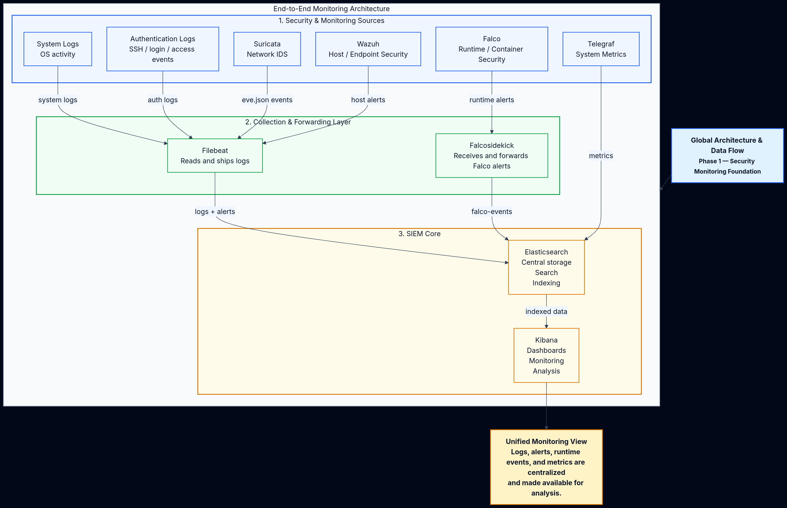
1-GLOBAL ARCHITECTURE & DATA FLOW

Slide 41
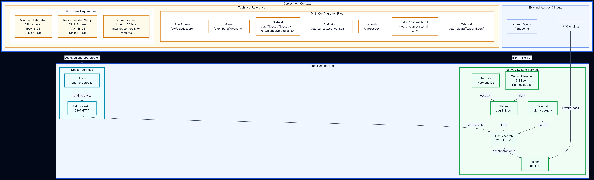
2-DEPLOYMENT, TECHNICAL SETUP & REQUIREMENTS

Slide 42
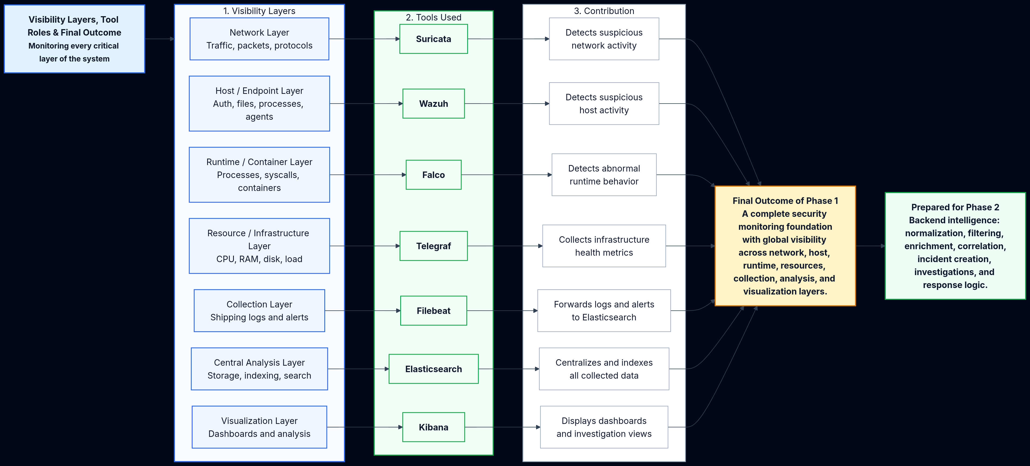
3-VISIBILITY LAYERS, TOOL ROLES & FINAL OUTCOME

Slide 43
Phase 3
Architecture

Slide 44
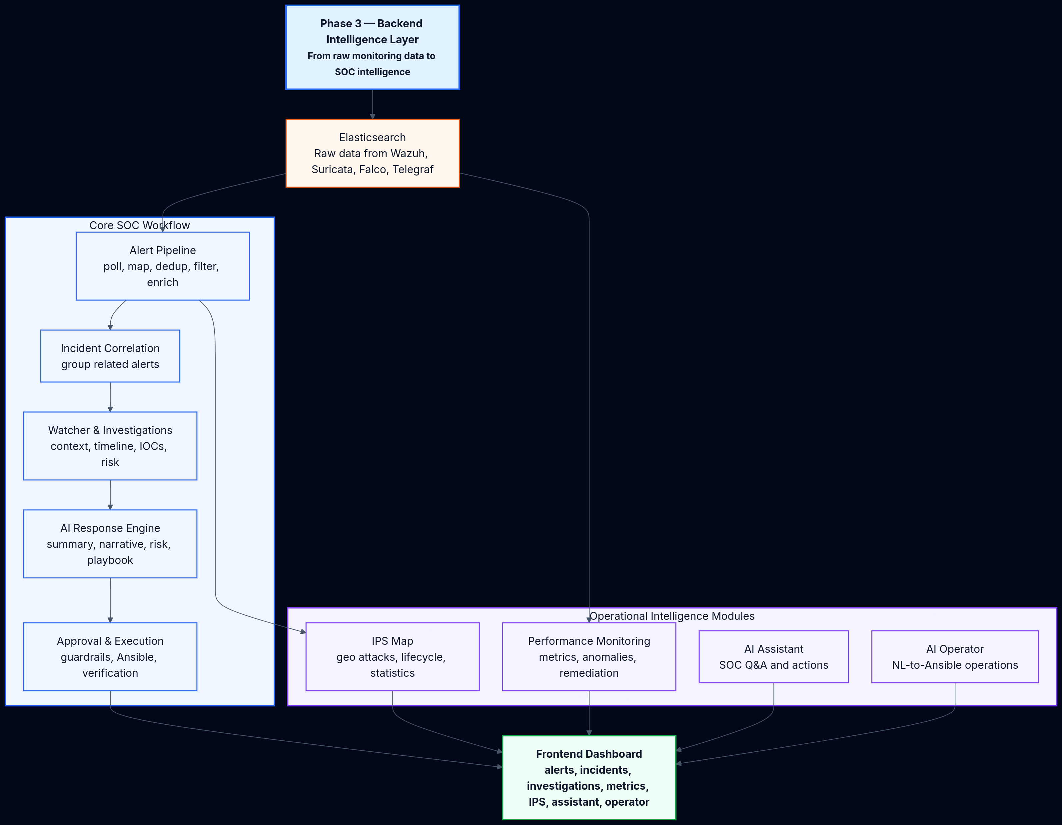
Diagram 1 — Global Phase 3 Backend Intelligence Layer

Slide 45
Diagram 2 — Alert Ingestion & Enrichment Pipeline

Slide 46
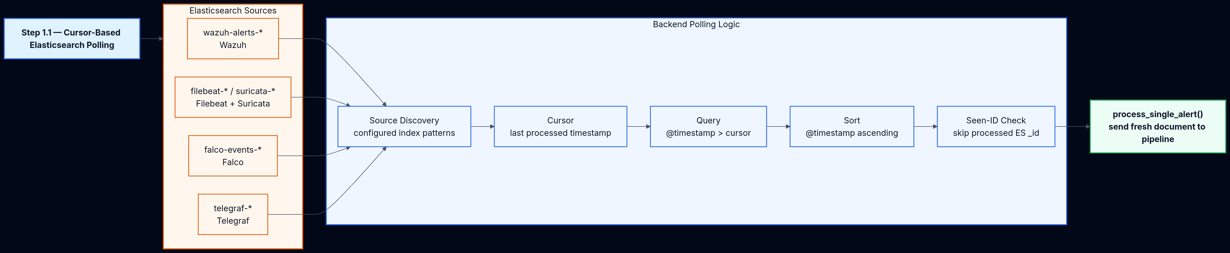
Diagram 3 — Cursor-Based Elasticsearch Polling

Slide 47
Diagram 4 — Raw Document to Clean SOC Alert

Slide 48
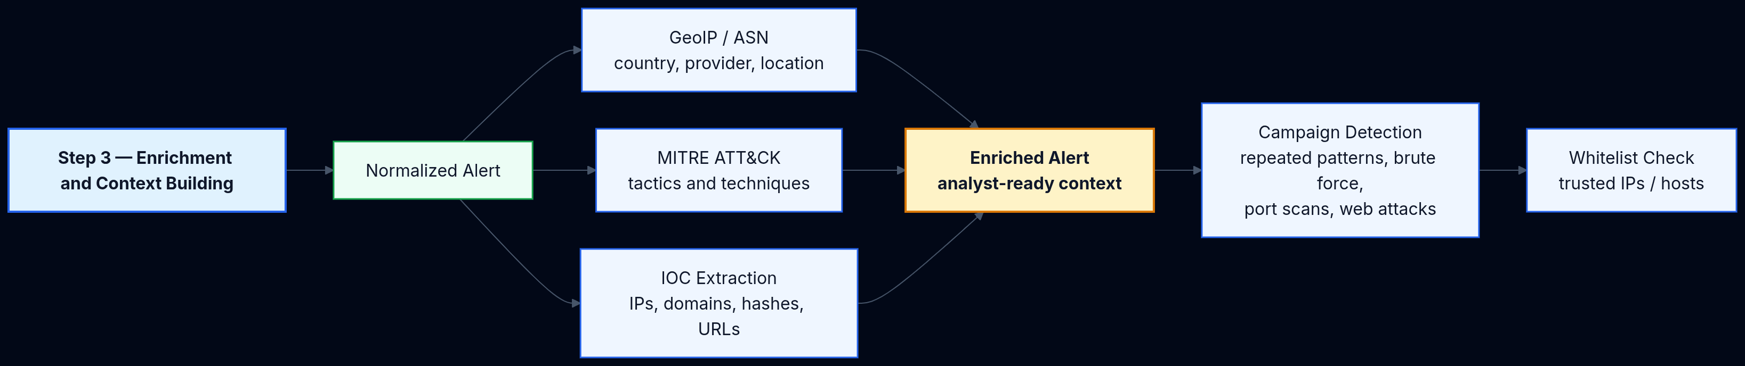
Diagram 5 — Enrichment and Context Building

Slide 49
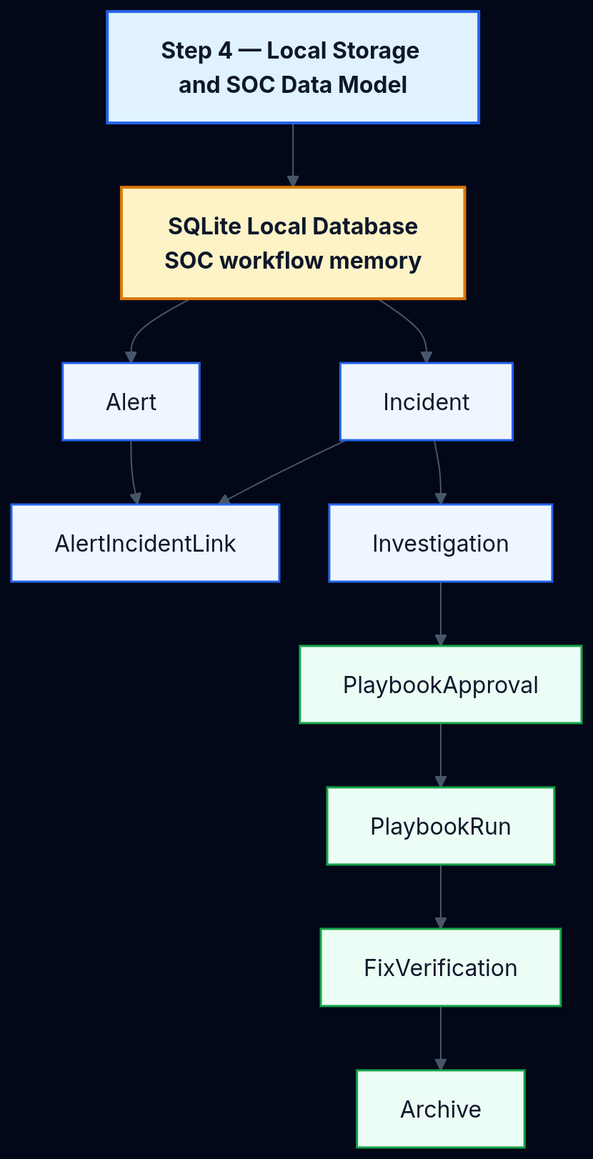
Diagram 6 — Local Storage and SOC Data Model

Slide 50
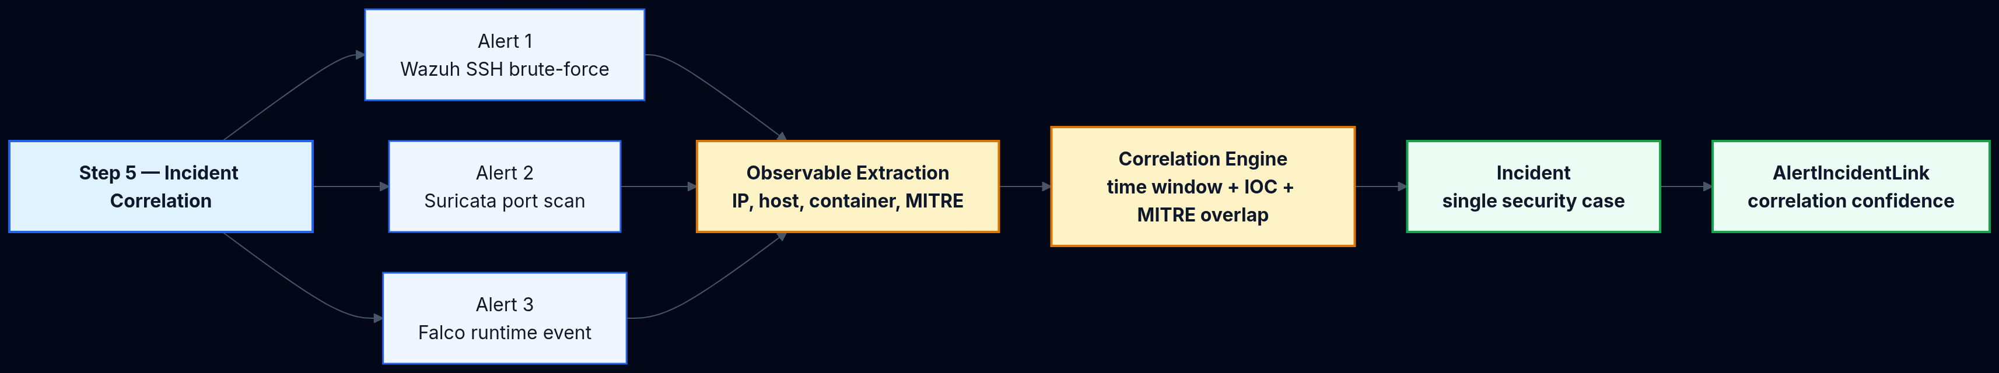
Diagram 7 — Incident Correlation

Slide 51
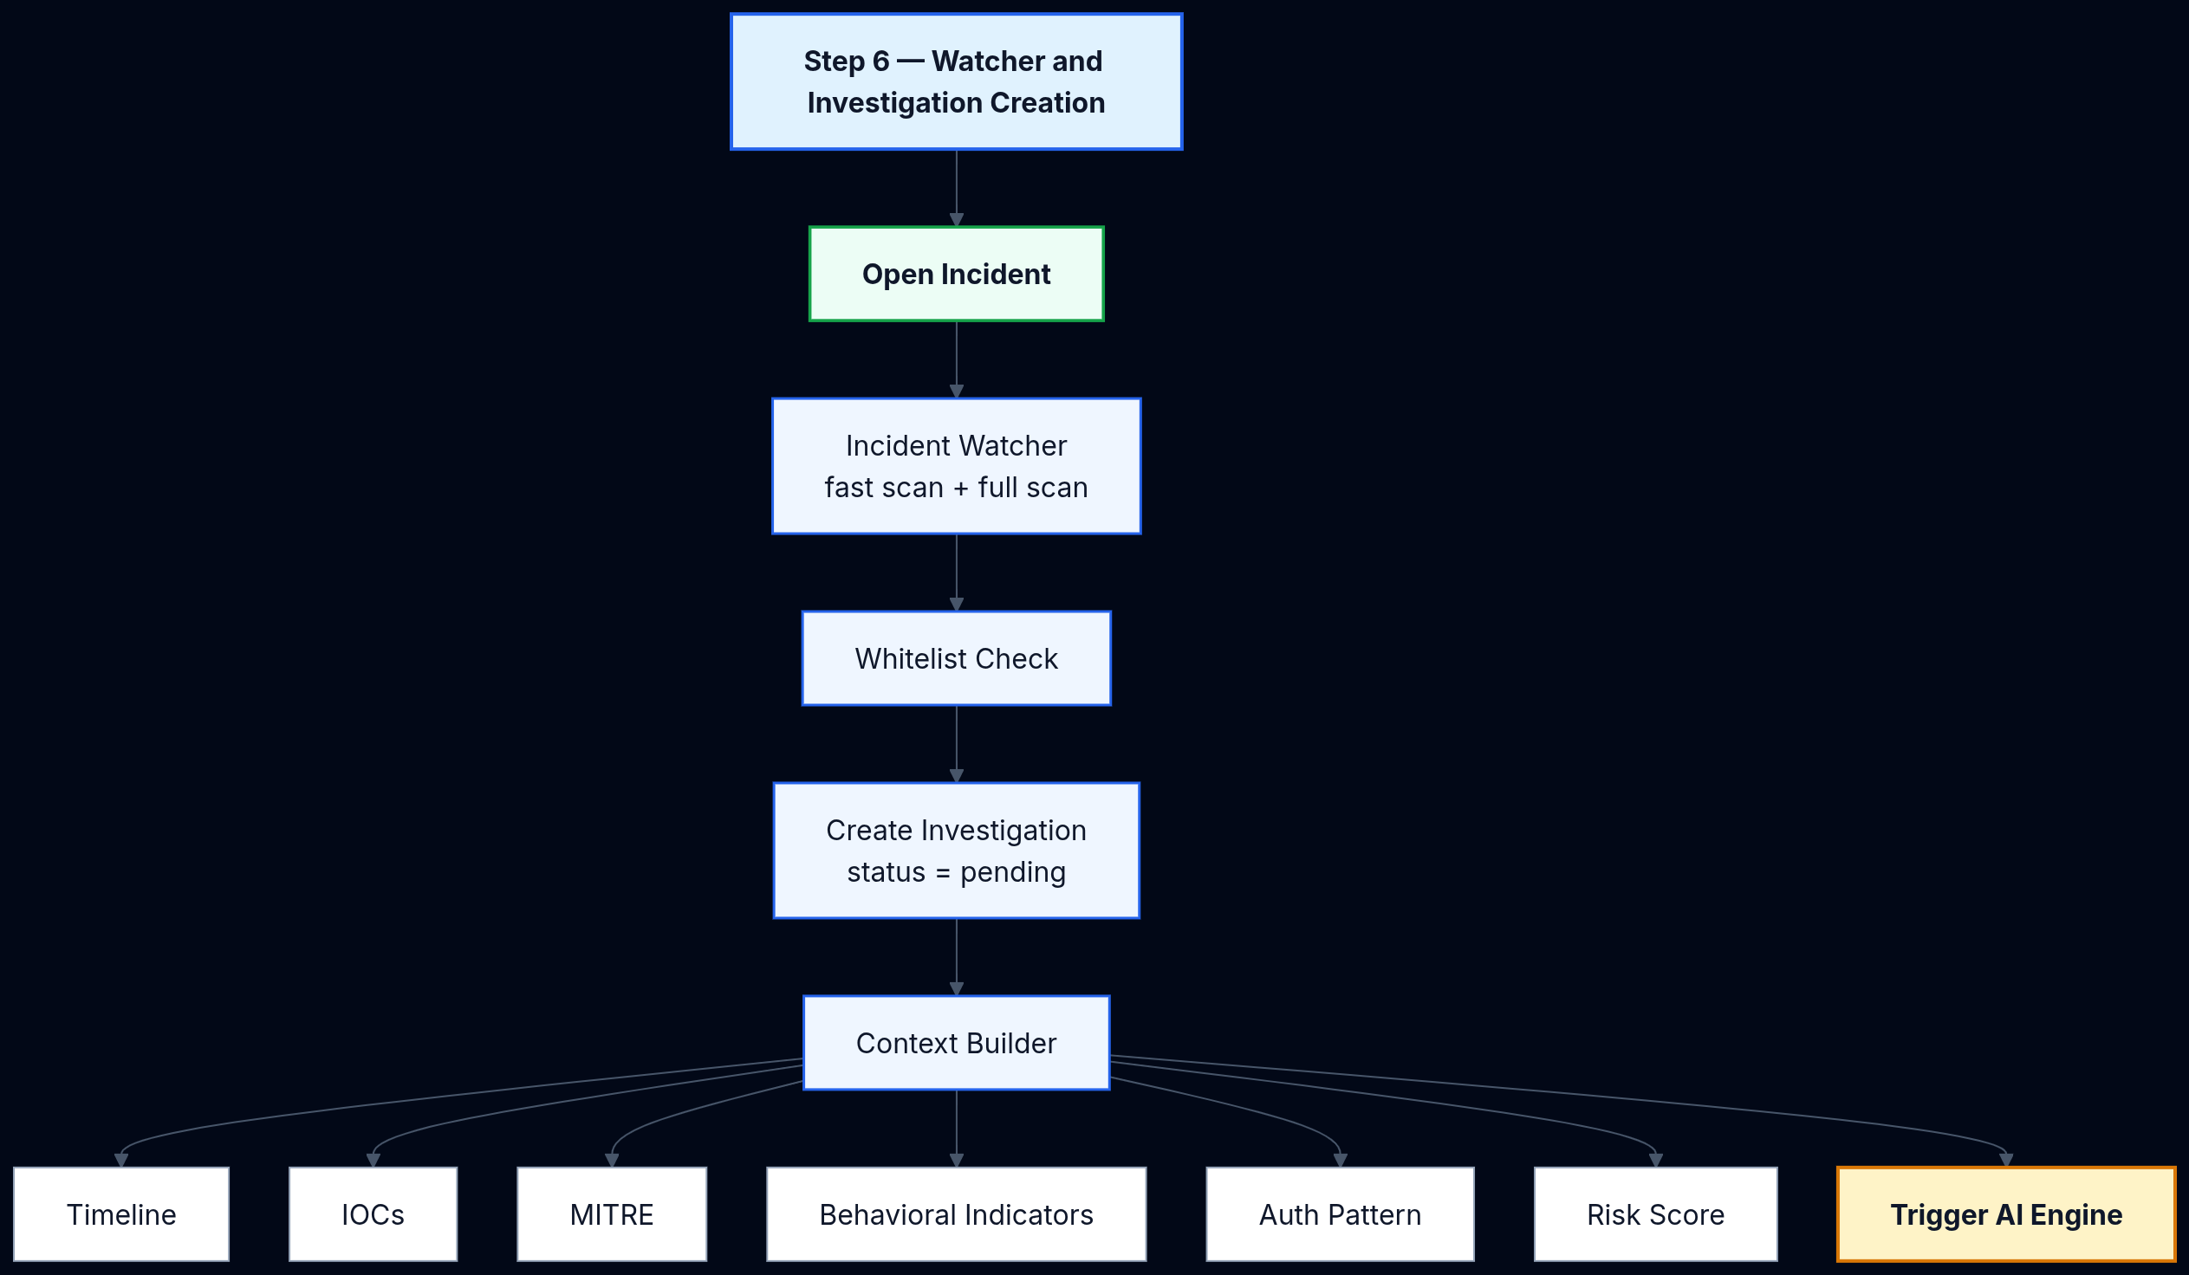
Diagram 8 — Watcher and Investigation Creation

Slide 52
Diagram 9 — AI Response Engine

Slide 53
Diagram 10 — Approval, Execution, Verification and Archive

Slide 54
Diagram 11 — Performance Monitoring and Remediation

Slide 55
Diagram 12 — IPS Attack Visualization

Slide 56
Diagram 13 — AI Assistant

Slide 57
Diagram 14 — AI Operator

